Slide 1
Simple Reproducible Small Groups
Tuesday Morning Mission Leaders Meeting Presentation by Jim Egli, Colorado Springs, CO, 10/2016

Slide 2
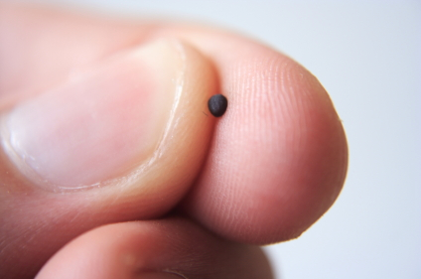
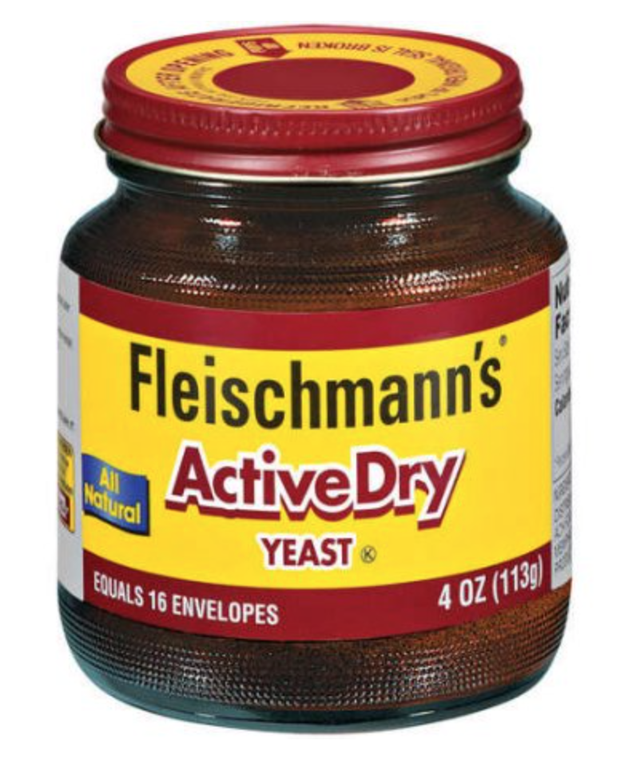
The Kingdom is Like…
Yeast
A Mustard Seed

Slide 3
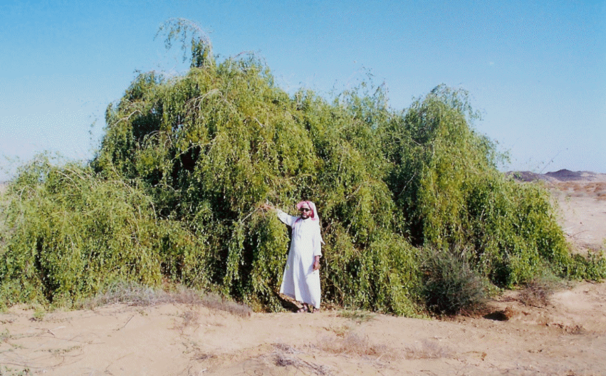
A Mustard Tree

Slide 4
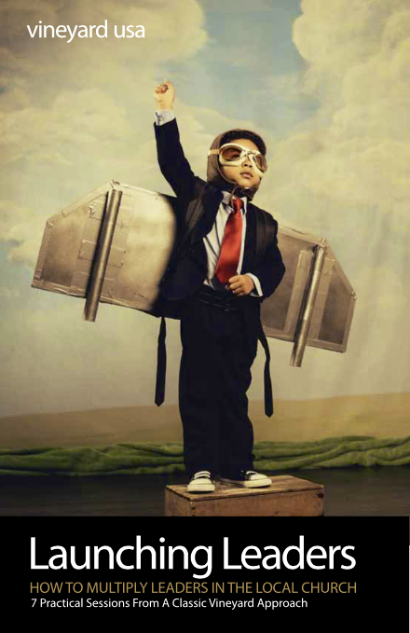
2 Paradigm Shifts
From “Doin’ the Stuff” to Giving Away Leadership
From Giving Away to Creating Systems to Fuel Growth

Slide 5
Addition or Multiplication Mindset?
The Leader Thinks… | Addition | Multiplication

Slide 6
Addition or Multiplication Mindset?
The Leader Thinks… | Addition | Multiplication
Growth Is Fueled by | Working Harder | Working Smarter

Slide 7
Addition or Multiplication Mindset?
The Leader Thinks… | Addition | Multiplication
Growth Is Fueled by | Working Harder | Working Smarter
They Need to Fix | People | System

Slide 8
Addition or Multiplication Mindset?
The Leader Thinks… | Addition | Multiplication
Growth Is Fueled by | Working Harder | Working Smarter
They Need to Fix | People | System
Organic Means | Simple | Complex

Slide 9
Addition or Multiplication Mindset?
The Leader Thinks… | Addition | Multiplication
Growth Is Fueled by | Working Harder | Working Smarter
They Need to Fix | People | System
Organic Means | Simple | Complex
As Ministry Grows | Workload Grows | Span of Care Remains the Same

Slide 10
Talk About It!
Discuss with 1 or 2 other people:
What is 1 thing that stands out to you from what was just presented?
Which of the 3 principles for moving from addition to multiplication… 1. Be Persistent 2. Be Eager to Learn 3. Keep Experimenting … is most important for you right now?

Slide 11
Key DMM Principles
Prayer is foundational.
Discipleship begins before conversion.
God is already drawing people and we just need to partner with him. (John 5:19) – “Do what the Father is doing!”
Simple and immediate obedience to the Bible is central.
The thrust of the groups is outward to more relational networks.

Slide 12
Discovery Group Format
What are you thankful for this week?
With whom did you share last week? How did it go with your “I Will’s”?
What does it say? (Retell and read the passage out loud.)
How would I say that? (Restate or retell in your own words.)
What must I do to obey what I have learned? “I will...”
With whom will you share what you learned this week?
What is one challenge you are facing? How can our group can help?

Slide 13
Try It!
Form groups of 4 or 5, then follow the Discovery Group format using Matthew 28:16-20, answering questions 1, 4, 5, 6, and 9.
What did you learn?
How did it go?

